Slide 1
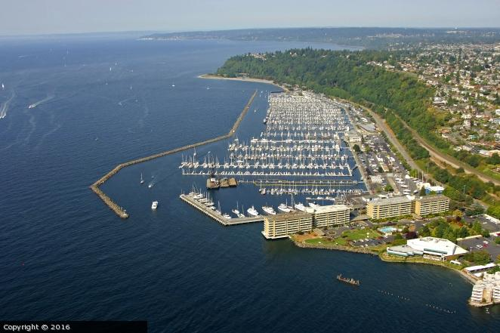
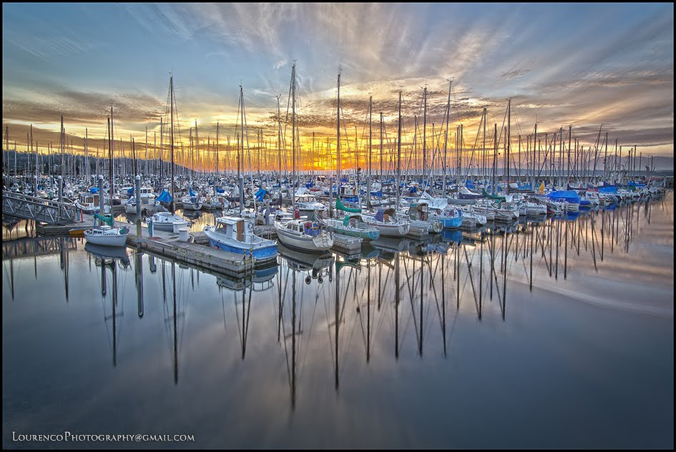
Shilshole Bay Marina
Customer Service Facilities
60% Design Update

Slide 2
Welcome & Introductions
    Port Staff:
    Tracy McKendry – Director, Recreational Boating
    Mark Longridge – Capital Project Manager
    Rosie Courtney – Public Affairs Manager
    Designers:
    Marcel Bodsky – Project Manager, Tetra Tech
    Tom Roth – Lead Architect, Tetra Tech
Project Team

Slide 3
Agenda
Project Overview
Design Overview & Details
Sustainability Aspects
Questions & Answers
Topics for Tonight

Slide 4
Project Overview
Goal:
Update the facilities & improve the customer experience at Shilshole Bay Marina
Primary Scope:
2 new larger South/Central Restroom & Laundry buildings (~2,600 sf each)
1 smaller North Restroom (~800 sf)
Convert current M2 & M5 restrooms to utility buildings, demolish M4 & M6
What’s the Plan?

Slide 5
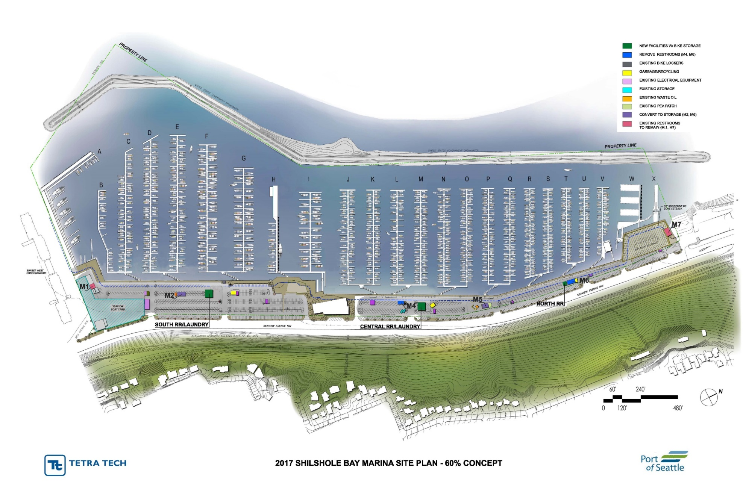
Project Overview
Site Plan

Slide 6
Project Overview
Building/Design Goals
Warm
Dry
Light
Comfortable
Easy Accessibility
Energy Efficient
Sustainable
Higher Capacity
Shorter wait times
Better functionality
Balancing All the Goals for the Best Design

Slide 7
Project Overview
Schedule
Currently at 60% Design Review
Next stop 90% Design & Permit Submittal
Final plans and bidding by March 2018
Construction scheduled to start Spring 2018
New facilities scheduled to open Fall 2018
Where Are We Now & What’s Next?

Slide 8
Project Overview
2017
Schedule:
Remaining Design
Permit Approval (DCI)
Prepare Final Bid Documents
Bidding & Contract Award
Construction
2018
J
J
A
S
O
N
D
J
F
M
A
M
J
J
A
S
O
N
D
Where Are We Now, & What’s Next?

Slide 9
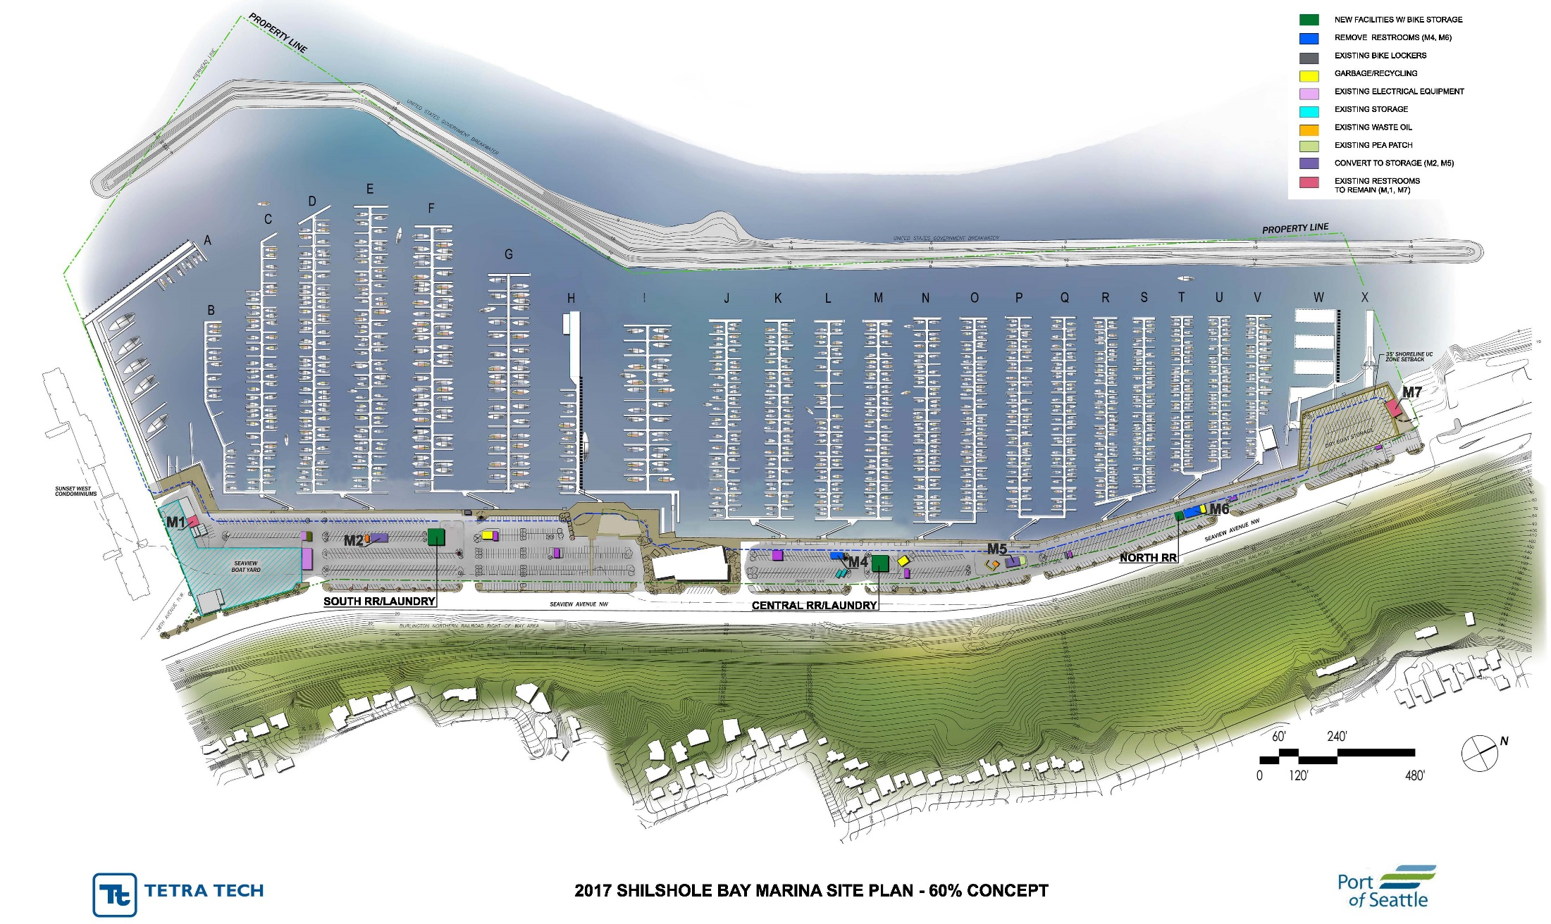
Project Overview
Site Plan

Slide 10
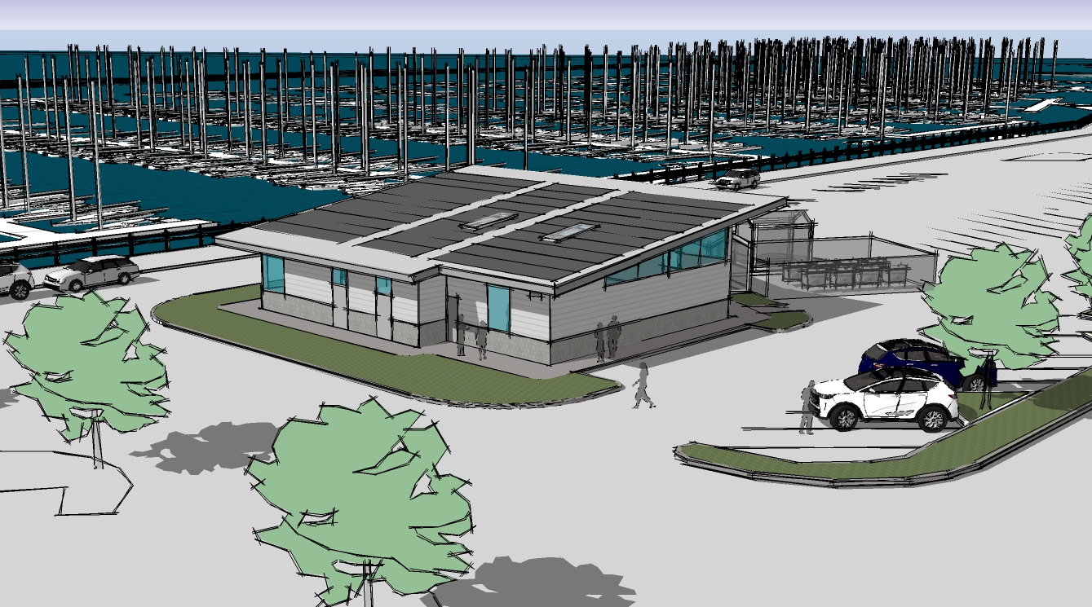
Central Restroom, Looking Northwest

Slide 11
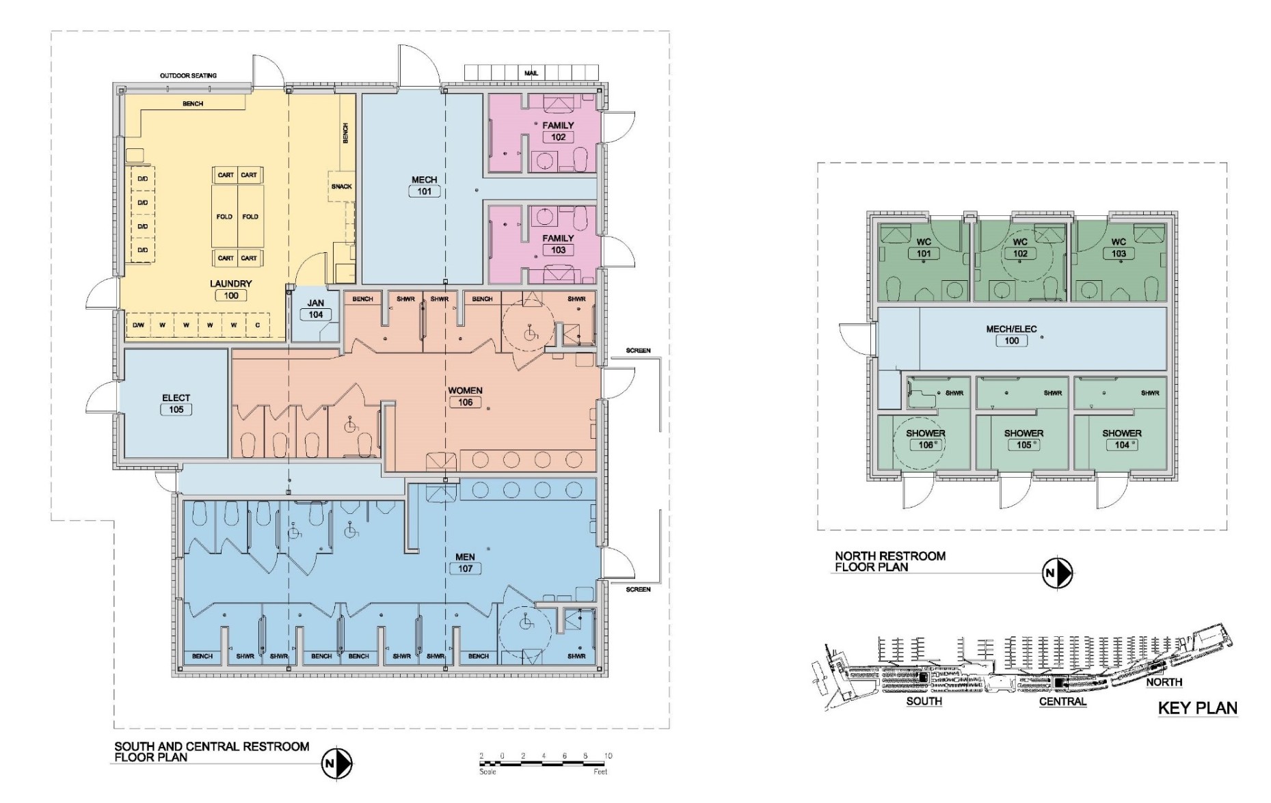
(South/Central)
***Floorplan***
Fixture Count vs existing (all bldgs)
Floorplans

Slide 12
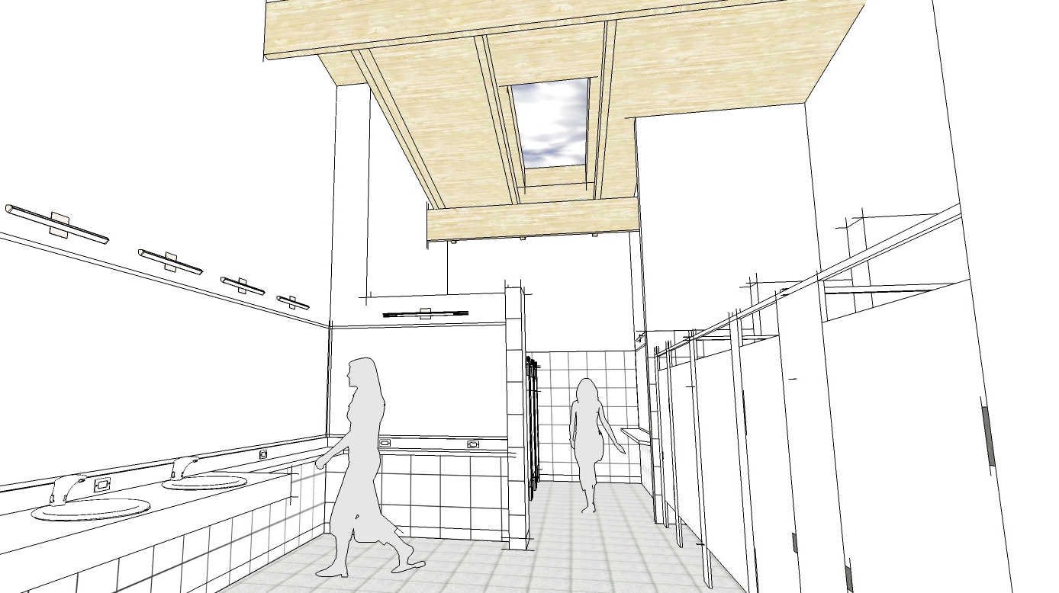
Conceptual View of Womens Restroom

Slide 13
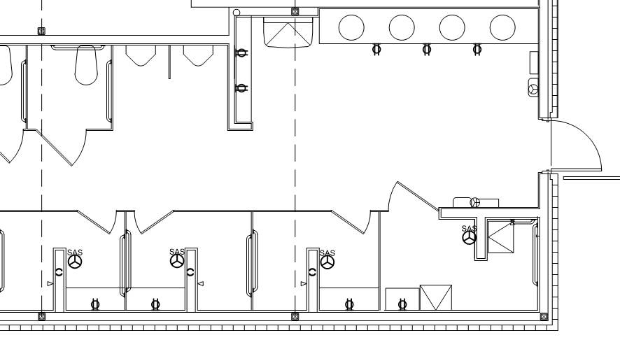
***Insert shower slide***
Shower Layout – Private Stalls With Wet & Dry Areas

Slide 14
Fixture Counts
RESTROOMS | Existing | Proposed | Change | % Change
Lavs | 29 | 31 | 2 | +7%
Toilets | 28 | 31 | 3 | +11%
Urinals | 15 | 10 | -5 | -33%
Showers | 19 | 32 | 13 | +68%
LAUNDRY | Existing | Proposed | Change | % Change
Washers | 5 | 10 | 5 | +100%
Dryers | 9 | 18 | 9 | +100%
Utility Sinks | 0 | 2 | 2
UNISEX PRIVATE FACILITIES
 | Existing | Proposed | Change | % Change
 | 4 | 7 | 3 | +75%
Increases in Most Facilities, Especially Showers & Laundry

Slide 15
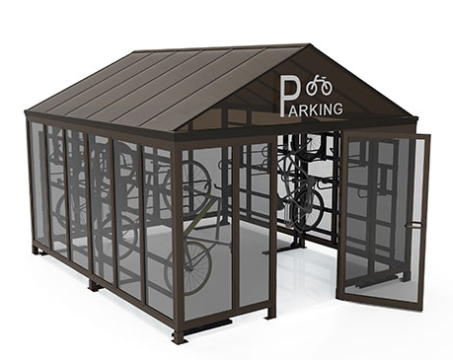
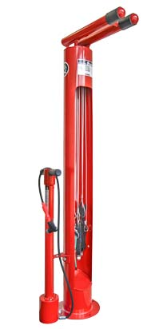
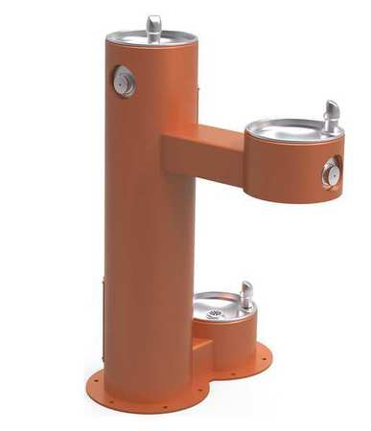
SECURE BIKE STORAGE
BOTTLE FILLER
WATER FOUNTAIN
DOG WATER DISH
BIKE REPAIR
CENTER
Site Amenities

Slide 16

DOG WASH!
(OUTDOOR)
Typical Site Amenities

Slide 17
Sustainability
Sustainable and responsible business practices are integral to the Port's strategic business objectives.
Planning for:
Solar Photovoltaics (PV) rooftop arrays
Geothermal heat pump HVAC systems
Committed to Sustainable Design

Slide 18
Sustainability
Solar Photovoltaics
Arrays on each of the larger buildings (South & Central)
Up to 50kW systems per building, producing around 52,000 kWh in an average year
(average Seattle homes consume ~12,000kWh/yr)
Goal is to cover over 65% of total restroom electrical load, and 100% of the ground source heat pump load
Paired with high efficiency design throughout (low flow fixtures, LED lighting etc)
Committed to Sustainable Design

Slide 19
Sustainability
Geothermal Heat Pumps
Use much less energy than conventional heating systems, since they draw heat from the ground. Not only does this save energy and money, it reduces air pollution.
Like an air source heat pump, but uses the natural consistency of ground temperature to heat the building
Committed to Sustainable Design

Slide 20
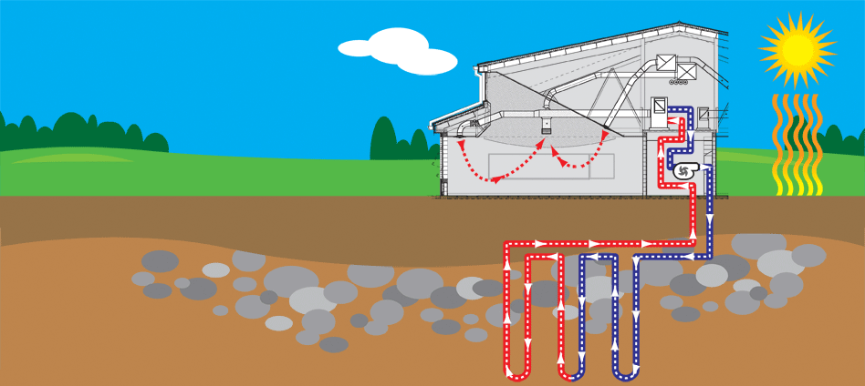
Sustainability
Geothermal Heat Pumps
Paired with radiant
heating in larger
buildings offers system
with over 500% efficiency
rating
Committed to Sustainable Design

Slide 21
Sustainability
Geothermal Heat Pumps
The Port’s first Geothermal heat system, but used in many other local projects and jurisdictions.
King County Libraries Newcastle Branch
Tukwila Branch
Duvall Branch
Snohomish School District Valley View Middle School
Seattle School District Adams Elementary School
Madison Middle School
Veteran’s Administration American Lake Campus
Snohomish PUD Headquarters
Lake Washington School District Carl Sandburg Elementary
Committed to Sustainable Design

Slide 22
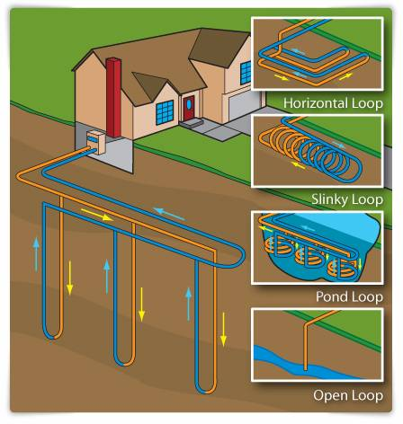
Sustainability
Closed vertical loop, completely contained system
5-10 wells, 300’ deep at each of the larger buildings
Committed to Sustainable Design

Slide 23
Project Overview
2017
Schedule:
Remaining Design
Permit Approval (DCI)
Prepare Final Bid Documents
Bidding & Contract Award
Construction
2018
J
J
A
S
O
N
D
J
F
M
A
M
J
J
A
S
O
N
D
Where Are We Now, & What’s Next?

Slide 24
Questions?

